Slide 1
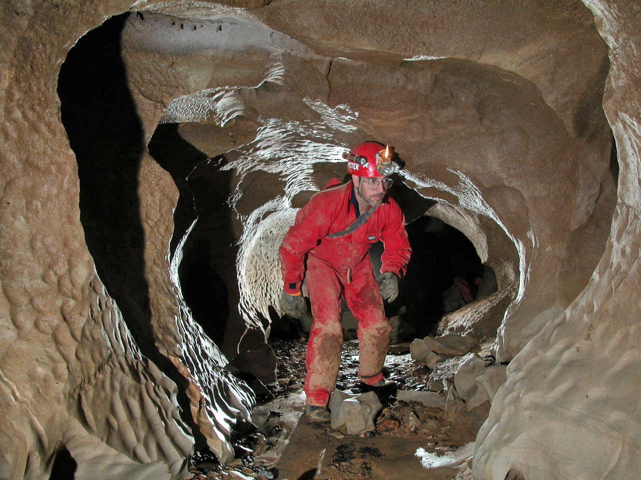

Intro to Splunk for Security Professionals

Slide 2

Intro to Splunk
Today
1. Splunk basics
2. Enterprise Security (ES) SIEM App
3. Typical deployment architecture
4. Investigation
5. Reports and alerts

Slide 3
Intro to Splunk
Disclaimer
-Not a production environment: data was artificially generated
-Splunk Enterprise uses slightly different indexes than used in class.
-SourceName is used instead of Source. There could be other small variations given setup limitations.

Slide 4
Intro to Splunk
Disclaimer
These slides complement the live condensed one-day Splunk workshop. They are not meant to be used as a stand-alone guide and may miss some context.

Slide 5
Intro to Splunk
Start Splunk!
-Settings > Access Controls > Add a user > Create your user
-Assign Administrator Role
Exit Splunk, log back as your user

Slide 6
Intro to Splunk – Class Exercise – Quick Analysis using GUI Only
Search for all VPN events.
SourceName=”VPN”
In the Timeline chart, zoom out and zoom in as necessary. Use “Zoom to Selection” to focus on a specific timeframe.
2. Who uses VPN the most?
Expand the first event using >.
Click on the userName field to see top 10 values.
3. When was the earliest recorded VPN event for that most active VPN account? The latest?
Expand the first event using > . Click username, click the first account name. Note the addition to the search query. Now, repeat #2.
4. How many users failed login VS successful logins?
Click on the Action field to find out.

Slide 7
Intro to Splunk – Class Exercise – Quick Analysis using GUI Only
3. When was the earliest recorded VPN event for that most active VPN account? The latest?
Expand the first event using > . Click username, click the first account name. Note the addition to the search query. Now, repeat #2.
4. How many users failed login VS successful logins?
“Action” field to find out.

Slide 8
Intro to Splunk – Class Exercise – Analysis with SPL
Commands: table , rename , sort , dedup, rename, time modifiers
1. In a table, select users who logged on to Diamond-02 in the last 21 days. Select the following fields: _time "Account_Name", "Client_Address", Workstation_Name“. Sort by _time, then sort by Workstation_Name. Rename all these fields to something else.
2. Repeat #1 but for all Diamond servers. Use the earliest and latest time modifiers to limit the search for all events that took place two months ago until one week ago. earliest=-2month latest=-1week
3. Repeat #2 for all servers BUT Diamonds. Dedup by Account_Name.

Slide 9
Intro to Splunk – Class Exercise – Charts and Visualizations
1. Produce a chart showing the top 10 websites accessed
Which chart to use? Try Pie, Column, etc.
2. Who fails VPN logins the most?
Show in a chart the top 5 users.
3. For all VPN logins, show failed VS successful logins. Limit your search for the last 2 month using time modifiers.
4. Select a user and show their failed Windows logins for any Diamond server over the last 12 weeks. Use timechart.

Slide 10
Intro to Splunk
Why use Splunk?
Super fast
Apps, extensions, SDK
Conf
Slogans

Slide 11
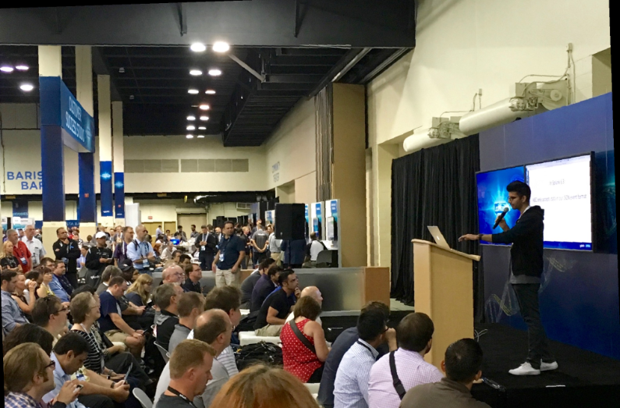
Intro to Splunk
Why use Splunk?
Super fast
Apps, extensions, SDK
Conf
Slogans

Slide 12

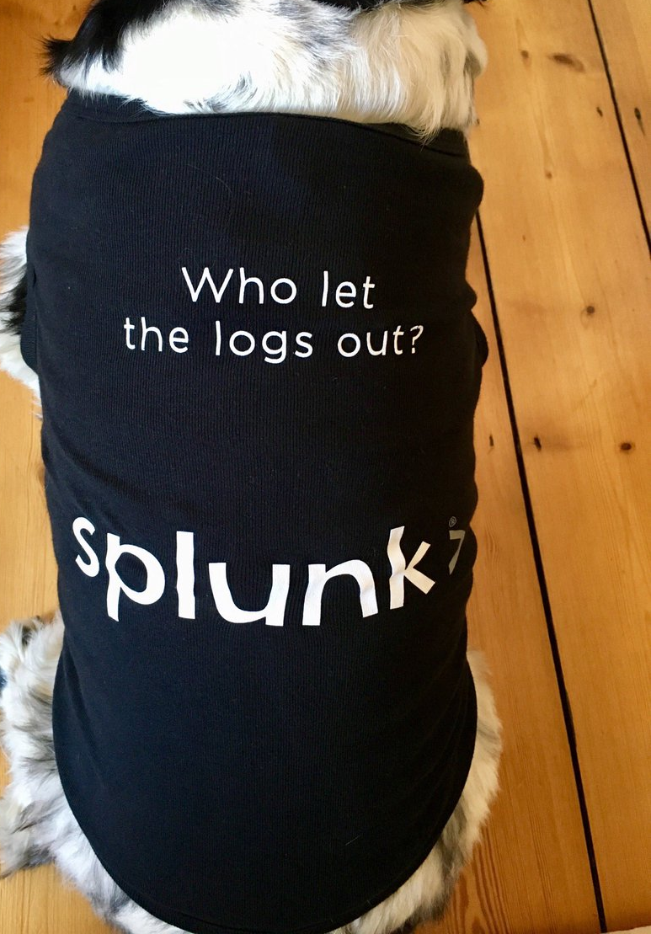

Intro to Splunk
Why use Splunk?
Super fast
Apps, extensions, SDK
Conf
Slogans

Slide 13
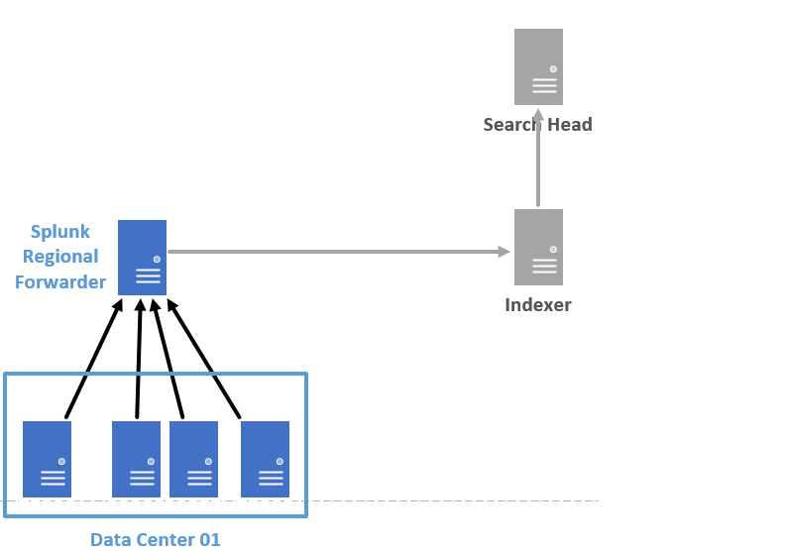
Intro to Splunk
On-Prem

Slide 14
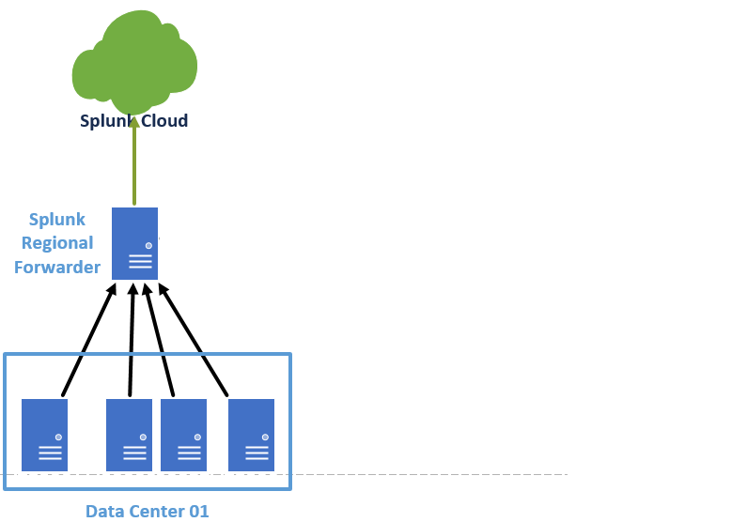
Intro to Splunk
Cloud

Slide 15
Intro to Splunk – Class Exercise – Data Import and Field Extraction
Download Customer_Shipment_Data.txt from
tiny.cc/03z8ty

Slide 16
Intro to Splunk – Class Exercise – Stats
Who successfully logs on to servers the most (EventCode=4624)? The least?
For #1, Add | eval DayOfWeek = strftime(_time, “%a”) | to extract logon day of week. Identify users who log in in the weekends.
Use | timechart to showing logon activity for these users.

Slide 17
Intro to Splunk – Class Exercise – Geolocations
For VPN connections:
1. Use a timechart to show failed VS successful VPN logins. Limit your search for the last 2 month using time modifiers.
4. Chart failed VPN locations

Slide 18
Intro to Splunk - Investigation
US-Based company
Was informed of a breach by FBI/SEC/NSA/CIA/SS/BK
Request our IR services
Goal: identify breach source and create incident
timeline ..in less than 2 hours

Slide 19

Intro to Splunk - Investigation
US-Based company
Was informed of a breach by FBI/SEC/NSA/CIA/SS/BK
Request our IR services
Goal: identify breach source and create incident
timeline ..in less than 2 hours

Slide 20
Intro to Splunk
Windows Events
tiny.cc/96y8ty

Slide 21
Intro to Splunk
Let’s investigate.

Slide 22
Intro to Splunk

